Slide 1
CGI Learning Center: Fact & Figures 2013
สถิติการปฏิบัติงานปี 2556
ศูนย์การเรียนรู้
สถาบันบัณฑิตศึกษาจุฬาภรณ์

Slide 2
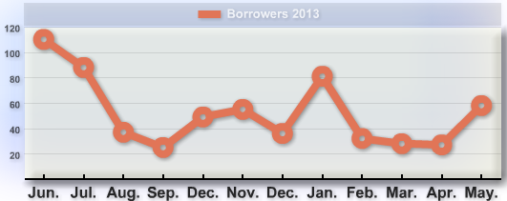
Books borrowed
Total 2013 collection
49 Titles 92 copies
Highest number
110 books borrowed in June
Total 626 times
Books borrowed
Total Hold Collection
404 Titiles 745 copies

Slide 3
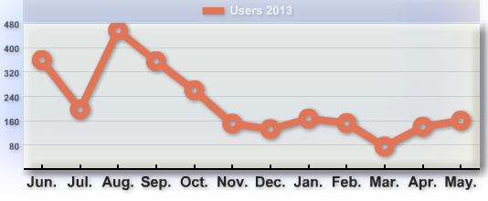
Visitors/customers
Who?
Total 4,291 visitors
CGI students/faculty/staff
Service use
How busy/when?
Highest number
On-line reference databases
Check-out books
455 visitors in August
Social media

Slide 4
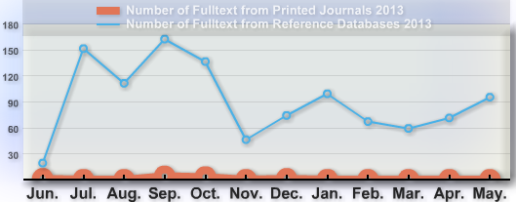
Document delivery
Downloads
Total 1,106 articles
Sources
Printed journals 16 articles
On-line articles 1,090 articles
Busy time?
Highest number service
In ….

Slide 5
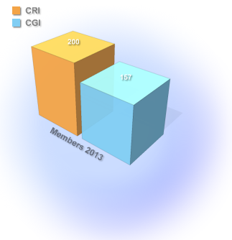
Members of CGI Learning Center
Population
Total 357
Communities
CGI 157
CRI 200

