Slide 1
CGI Learning Center
Fact & Figures 2014
สถิติการปฏิบัติงานปี 2557
ศูนย์การเรียนรู้
สถาบันบัณฑิตศึกษาจุฬาภรณ์

Slide 2
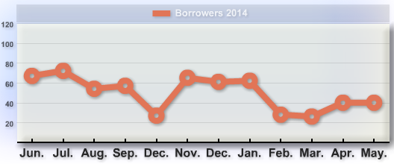
Books borrowed
Total 2014 collection
56 Titles 70 copies
Highest number
72 Times borrowed in July
Total 599 times
Books borrowed
Total Hold Collection
460 Titles 815 copies

Slide 3
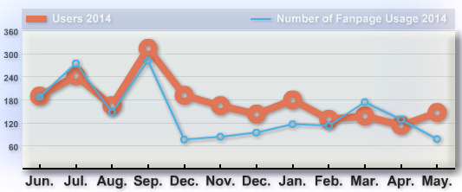
Visitors/customers
Who?
Total 3,857 visitors
CGI students/faculty/staff
Service use
How busy/when?
Highest number
On-line reference databases
Check-out books
313 visitors in September
Social media

Slide 4
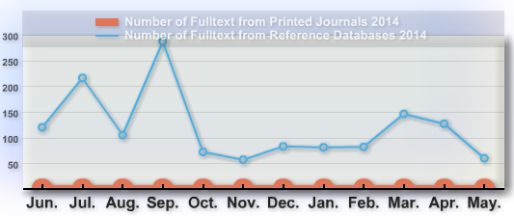
Document delivery
Downloads
Total 1,436 articles
Sources
On-line articles 1,436 articles
Busy time?
Highest number service
In September

Slide 5
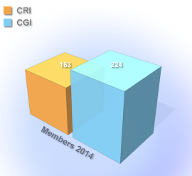
Members
Population
Total 387
Communities
CGI 224
CRI 163

