Slide 1
CGI Reference Databases 2019
Ms. Juthatip Niyomrat,
Information Specialists
https://www.facebook.com/CgiLearningCenter/
https://www.cgi.ac.th/library
July 11, 2019

Slide 2
01
List of CGI Reference Databases
CGI Learning Center provides 12 databases which includes 10 online databases under a cooperation with ThaiLis-Office of Higher Education Commission(OHEC) and CGI subscribe 2 online databases, with mostly available full-text of journal articles.
02
Related Reference Databases
For ABS, ET and CB students.
03
Library OPAC
To search CGI and CRI books.
04
Searching Tips
Preparing keywords, Operation keys, Refine Results and Manage result
.

Slide 3
List of CGI Reference Databases

Slide 4
Databases | Period | Remarks
1. SciFinder-n MethodsNow Registration Link *Please use your CGI/CRI Email only | FEB 2019 - SEP 2019 | CGI
2. Britannica the Encyclopedia | FEB 2019 - JAN 2020 | CGI
3. ACM Digital Library | NOV 2018 - OCT 2019 | OHEC
4. IEEE/IET Electronic Library (IEL) | NOV 2018 - OCT 2019 | OHEC
5. Web of Science | NOV 2018 - OCT 2019 | OHEC
6. ProQuest Dissertation & Theses Global | NOV 2018 - OCT 2019 | OHEC
7. SpringerLink – Journal | JAN 2019 - DEC 2019 | OHEC
8. American Chemical Society Journal (ACS) | JAN 2019 - DEC 2019 | OHEC
9. Academic Search Complete | JAN 2019 - DEC 2019 | OHEC
10. Emerald Management (EM92) | JAN 2019 - DEC 2019 | OHEC
11. Computer & Applied Sciences Complete (CASC) | JAN 2019 - DEC 2019 | OHEC
12. EBSCO Discovery Service Plus Full Text | JAN 2019 - DEC 2019 | OHEC
List of CGI Reference Databases

Slide 5
Related Reference Databases

Slide 6
Related Reference Databases
SciFinder
  SciFinderⁿ allows scientists to do better research in less time. SciFinderⁿ accelerates research by providing actionable results such as step-by-step synthetic methods and hard to find chemistry in patents.
Encyclopedia Britannica
  Encyclopædia Britannica, the oldest English-language general encyclopaedia. The Encyclopædia Britannica was first published in 1768, when it began to appear in Edinburgh, Scotland.

Slide 7
Related Reference Databases
EBSCO Discovery Service
  EBSCO Discovery Service (EDS) brings together the most comprehensive collection of content – including superior indexing from top subject indexes, high-end full text, and a library’s collection
American Chemical Society Journal (ACS)
  ACS Publications is dedicated to helping researchers advance scientific excellence to solve global challenges through journals, eBooks, scientific programs, and the newsmagazine Chemical & Engineering News.
SpringerLink – Journal
  Providing researchers with access to millions of scientific documents from journals, books, series, protocols, reference works and proceedings.

Slide 8
Related Reference Databases
ProQuest Dissertations & Theses : Full Text
  ProQuest Dissertation & Theses Global is the world's most comprehensive curated collection of dissertations and theses from around the world, offering 5 million citations and 2.5 million full-text works from thousands of universities all over the world.
ISI Web of Science
  Web of Science (Web of Knowledge) is an online subscription-based scientific citation indexing service that provides a comprehensive citation search. It gives access to multiple databases that reference cross-disciplinary research, which allows for in-depth exploration of specialized sub-fields within an academic or scientific discipline.

Slide 9
Library OPAC

Slide 10
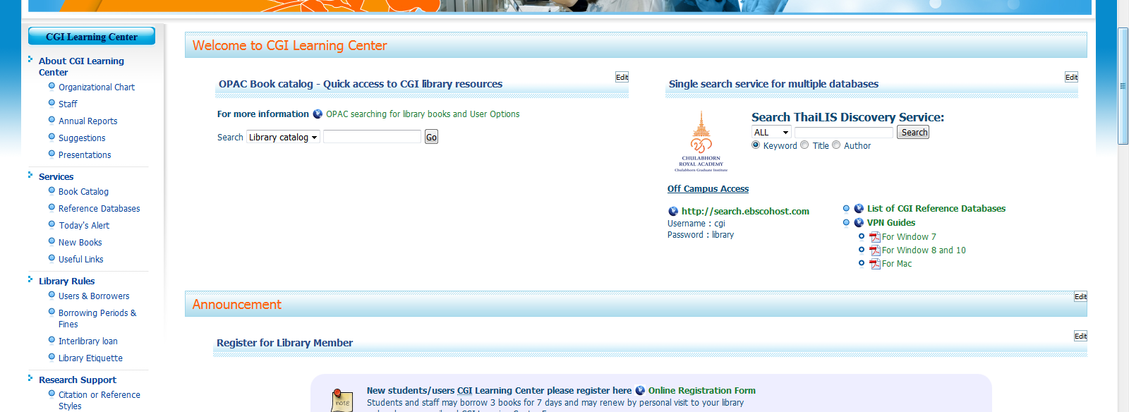
https://www.cgi.ac.th/library
We Create
Quality Professional
PPT Presentation
CGI Learning Center Website

Slide 11
Searching Tips

Slide 12
Searching Tips
Preparing Keywords
Operation keys
01
02
Refine Results
03
Manage result
04

Slide 13
Other Free Databases
Research Gate
http://www.researchgate.net
PUBMED
Google Scholar
http://www.ncbi.nlm.nih.gov/pubmed
https://scholar.google.com

Slide 14
Contact us
01
02
03
04
05
CGI Learning Center
Tel
Email
Homepage
Fanpage
02-554-1900
ext. 2145 (พี่ปู),
ext. 2147 (พี่นุก),
ext. 2712 (พี่พลอย)
learn@cgi.ac.th
http://www.cgi.ac.th/library
http://www.facebook.com/CgiLearningCenter
M Floor,
CGI Building
9.00 a.m. – 5.00 p.m.
D
D
D

