Slide 1
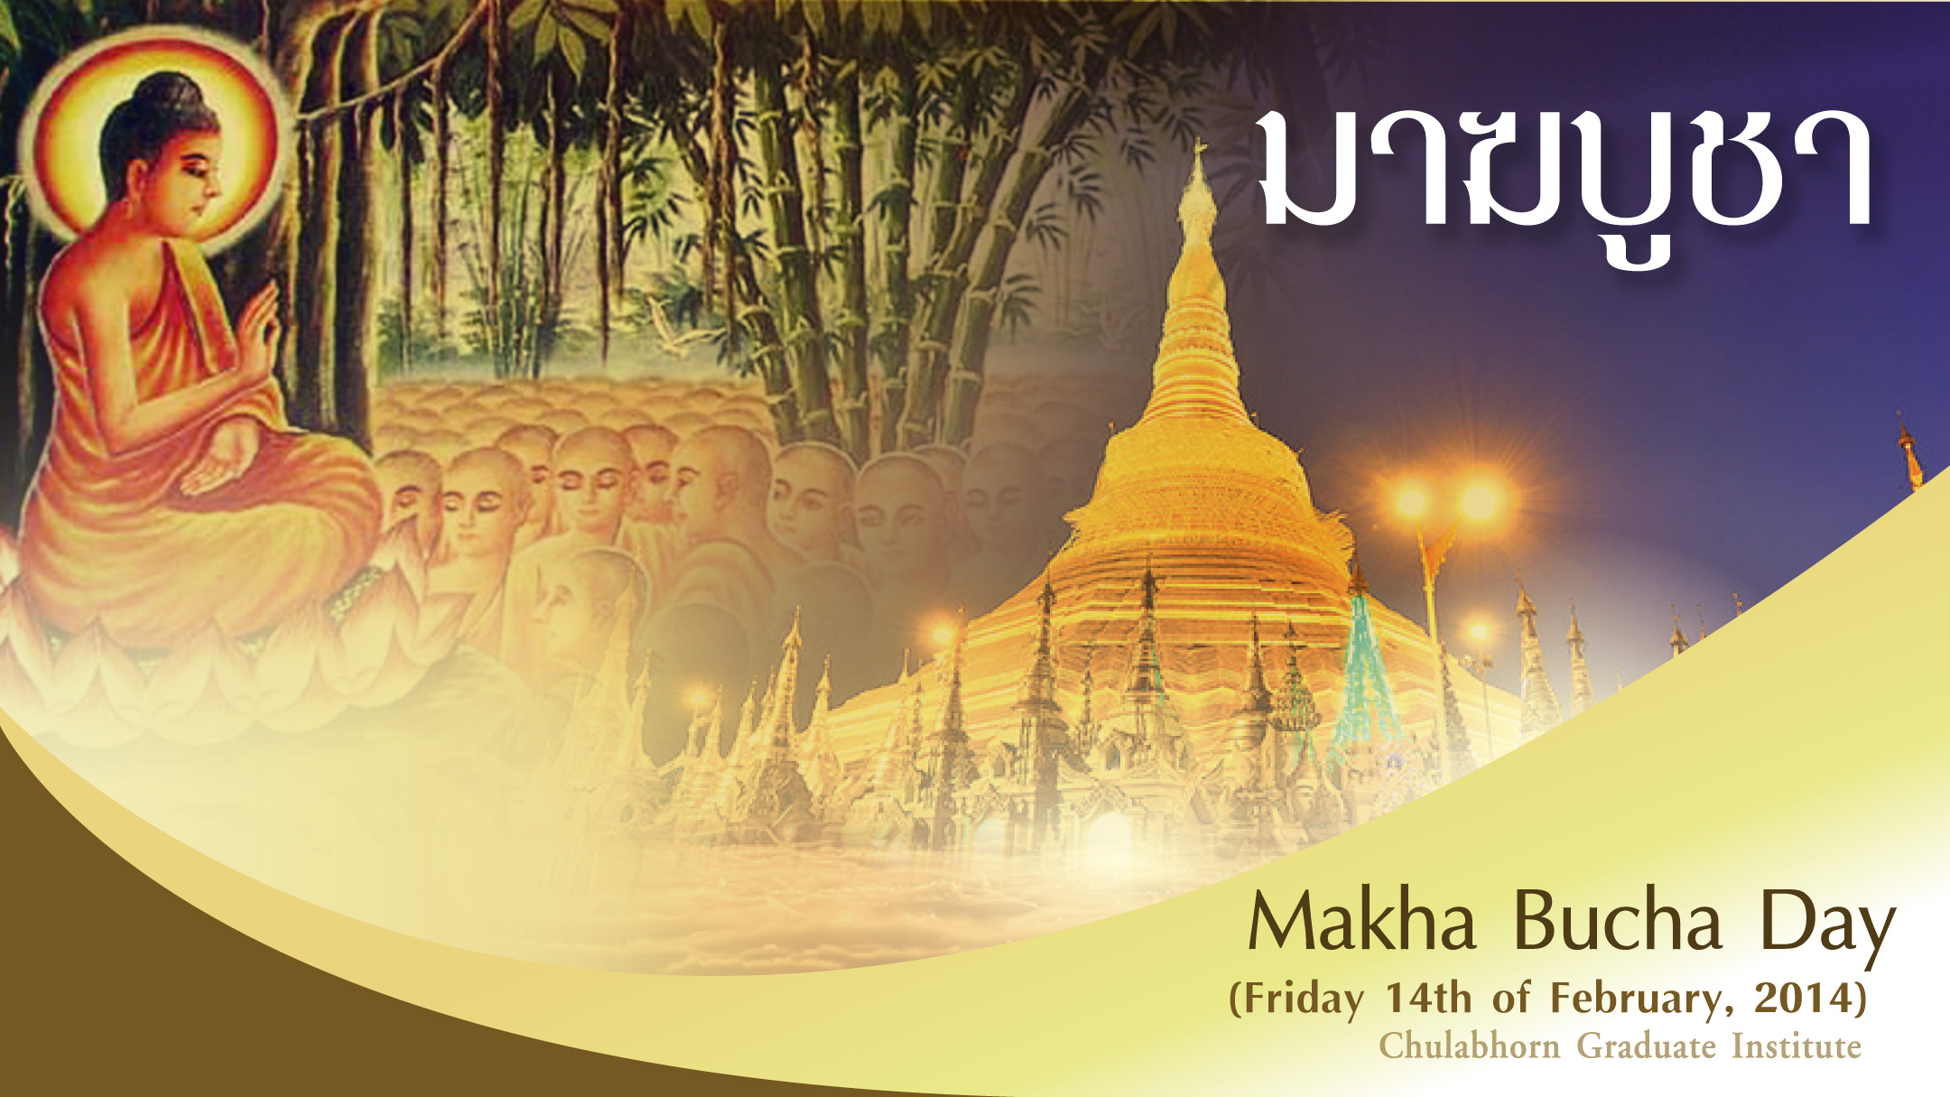

Slide 2
Magha Puja Day
ชลออ่าน

Slide 3
Magha Puja day marks the four auspicious occasions, which happened nine months after the Enlightenment of the Buddha at Veluvana Bamboo Grove, near Rajagaha in Northern India. On that occasion, as recorded in the commentary to the Mahasamayasutta, DN-Comm 20 four marvellous events occurred:
ชลออ่าน

Slide 4
1. There were 1,250 Arahata, that came to see the Buddha that evening without any schedule.
2. All of them were Arhantas, the Enlightened One, and all of them were ordained by the Buddha himself.
ชลออ่าน

Slide 5
3. The Buddha gave those Arhantas principles of Buddhism, called "The ovadhapatimokha". Those principles are:
- To cease from all evil,
- To do what is good,
- To cleanse one's mind;
ชลออ่าน

Slide 6
4. It was the full-moon day. The Buddha gave an important teaching to the assembled monks on that day 2,500 years ago called the 'Ovadapatimokha' which laid down the principles of the Buddhist teachings. In Thailand, this teaching has been dubbed the 'Heart of Buddhism'.
ชลออ่าน

Slide 7
Thailand Observance on February 14th, 2014
In the evening of Magha full-moon day, each temple in Thailand holds a candlelight procession called a wian tian (wian meaning circle; tian meaning candle). Holding flowers, incense and a lighted candle, the monks and congregation members circumambulate clockwise three times around the phra ubosot (ordination hall) - once for each of the Three Jewels – the Buddha, the Dharma, and the Sangha.
ชลออ่าน

Slide 8
2. Tum Boon : Making merit by going to temples for special observances and join in the other Buddhist activities.
ชลออ่าน

Slide 9
3. Rub Sil : Keeping the Five Precepts. Practise of renunciation: Observe the Eight Precepts, practise of meditation and mental discipline, stay in the temple, wearing white robes, for a number of days.
ชลออ่าน

Slide 10
The Celebration
In the morning many Thai people wake up early to give alms to monks. In the evening, temples are full of people listening to sermons. They often perform a ritual known as the candle ceremony where they walk clockwise three times around the temple. holding flowers, incense and a lighted candle.
ชลออ่าน

Slide 11
The people visit the temples to perform meritorious acts. They offer flowers, candles and incense in the temple and pray to Lord Buddha, expressing their repentance for their ugly deeds.
ชลออ่าน

Slide 12
Thereafter, the monk addresses the people collectively and they listen to him with full attention. Later, a candle-lit procession is taken out and the faithful participate in it with great zeal.
ชลออ่าน

Slide 13
This ceremony marks two important dates in the life of Buddha. The first event occurred two years after Buddha’s enlightenment and is referred to as the Fourfold assembly.
ชลออ่าน

Slide 14
All of these occurred on full moon day of the third lunar month. As part of this gathering Buddha gave the basic principles of Buddhism to the monks. These principles are:
Not to do any bad deeds
To do good deeds
To cleanse the mind of impurities.
ชลออ่าน

Slide 15
If everyone followed these principles we would have a peaceful family, peaceful community, peaceful nation, and peaceful world. Or put another way, we would have peaceful and happy lives.
ชลออ่าน

Slide 16
The second event occurred in the second half of Buddha’s life on Makha Puja day. Buddha delivered a sermon called "Keys for success". The second event was three months prior to his passing away.
ชลออ่าน

Slide 17
During this ceremony lay people focus more intensely on Dhamma and meditation. Dhamma (or Dharma) as it is sometimes referred to is the teachings of Buddha. Lay people would typically take vows to refrain from bad habits and perform acts to benefit them spiritually. The Keys are as follows:
ชลออ่าน

Slide 18
Good will and good intention (Chanda)
Effort (Viriya)
Thoughtfulness (Citta)
Investigation (Vimangsa)

Slide 19
THANK YOU
ชลออ่าน

